Slide 1
Mos & cmos logic
CSE 211
Lecturer Uzma Hasan, CSE department, MIST

Slide 2
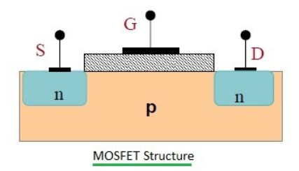
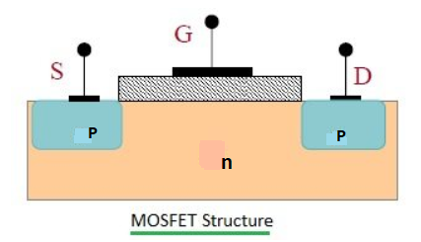
Mos basics
The MOSFET (Metal Oxide Semiconductor Field Effect Transistor) is a semiconductor device which is widely used for switching and amplifying electronic signals in the electronic devices.
It is mainly a three terminal device such as source, gate, and drain.
MOSFET is very far the most common transistor and can be used in both analog and digital circuit
MOSFET works by varying the width of a channel along which charge carriers flow (holes or electrons).
The charge carriers enter the channel from the source and exit through the drain.
The channel width is controlled by the voltage on the gate terminal which is located between the source and drain. It is insulated from the channel near an extremely thin layer of metal oxide.
N channel
P channel

Slide 3
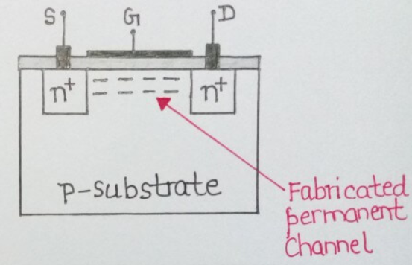
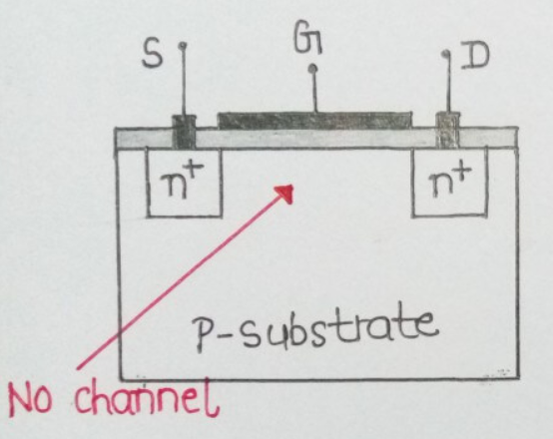
Types of Mosfet(important for 5-7 marks)
The MOSFET is classified into two types such as:
1.Depletion Mode: The depletion mode MOSFET is equivalent to a “Normally Closed” switch at zero gate voltage. The transistor requires the Gate-Source voltage, ( V_{GS} ) to switch the device “OFF”.
In depletion MOSFET, the channel is permanently fabricated (by doping) at the time of construction of MOSFET itself.
2.Enhancement Mode: The enhancement mode MOSFET is equivalent to a “Normally Open” switch. When there is no voltage on the gate terminal the device does not conduct. It requires a Gate-Source voltage, ( V_{GS} ) to switch the device “ON”. More voltage applied on the gate terminal, the device has good conductivity.
In Enhancement MOSFET, the channel does not exist initially and is induced i.e the channel is developed by applying a voltage greater than threshold voltage, at the gate terminals.
Depletion
Type
Enhancement
Type

Slide 4
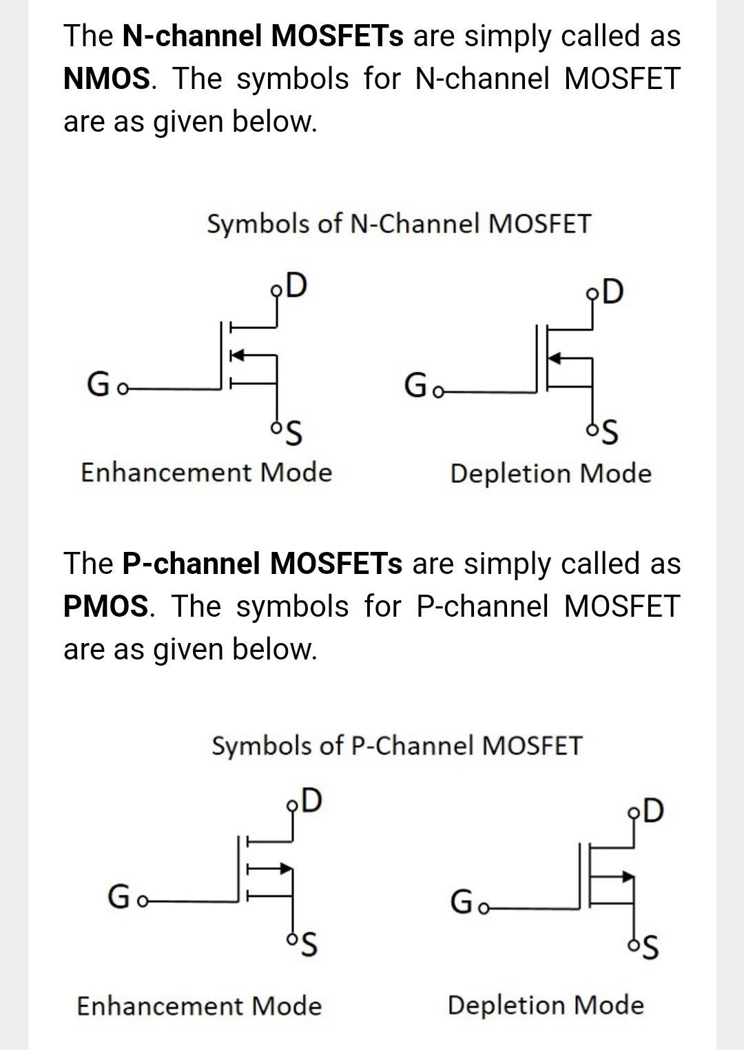
Nmos & pmos

Slide 5
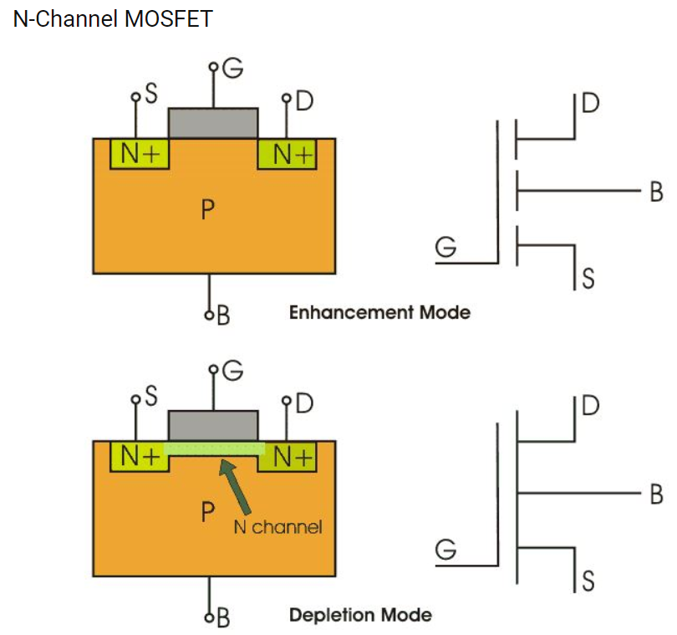
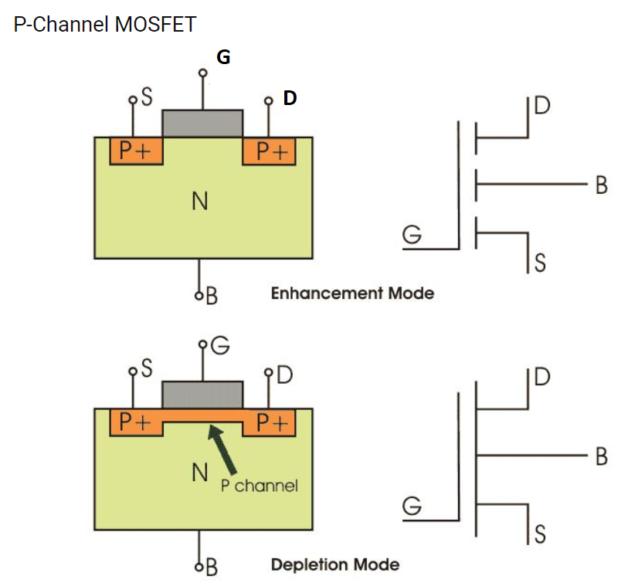
nmos & pmos
Notes:
N-Channel MOSFET: The drain and source are heavily doped n+ region and the substrate is p-type. The current flows due to the flow of negatively charged electrons, also known as n-channel MOSFET. When we apply the positive gate voltage the holes present beneath the oxide layer experience repulsive force and the holes are pushed downwards. The positive gate voltage also attracts electrons from n+ source and drain region in to the channel thus an electron rich channel is formed. Now, if a voltage is applied between the drain and source, the current flows freely between the source and drain and the gate voltage controls the electrons in the channel.
P-Channel MOSFET: The drain and source are heavily doped p+ region and the substrate is in n-type. The current flows due to the flow of positively charged holes also known as p-channel MOSFET. When we apply negative gate voltage, the electrons present beneath the oxide layer experience repulsive force and they are pushed downward in to the substrate. The negative gate voltage also attracts holes from p+ source and drain region into the channel region.

Slide 6
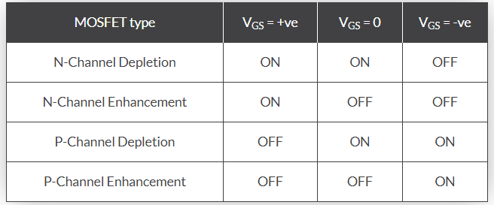
NMOS & Pmos summary

Slide 7
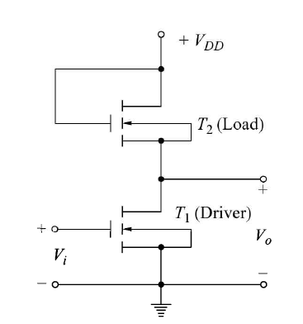
Mos inverter with enhancement load
Here, Vdd = 5V and voltage applied to gate to T2 is also 5V
So, T2 is always in ‘ON’ state
For T1, Vi = Vgs and Vo = Vds
If Vi = 0V, T1 = ‘OFF’
So, Vo gets connected to Vdd, i.e Vo = HIGH voltage (around 3.7 V)
When Vi = 5V, T1 = ‘ON’
So current from Vdd can flow through T1 to gnd
Thus, Vo = Vds = LOW voltage (around 0.3V)
Notes:
Both transistors T1 and T2 are Enhancement type MOSFET. When there is no voltage on the gate terminal then enhancement MOS does not conduct, i.e in OFF state. More voltage applied on the gate terminal, the device has good conductivity. So when HIGH voltage applied on gate terminal, the device is then in ON state. Usually threshold voltage of NMOS is Vt = 1 V. So if 1 V or more applied at gate terminal, the device starts conducting.

Slide 8
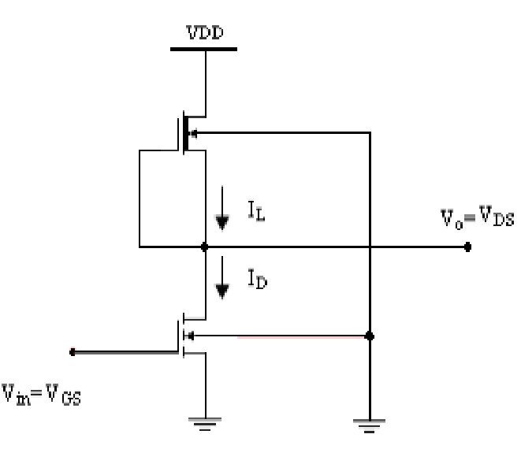
Mos inverter with depletion load
Transistor T1 is Enhancement type and T2 is Depletion type NMOS. Gate and source terminal of T2 is connected.
Threshold voltage for depletion type NMOS is – 4V i.e for T2, if Vgs > -4V, the transistor will be ON.
Here, Vgs = 0 V for T2. As there is no voltage applied to the gate terminal.
So T2 is always ON.
Now, when Vi = 0V applied, T1 = ‘OFF’
So, Vo gets connected to Vdd, i.e Vo = HIGH voltage
When Vi = 5V, T1 = ‘ON’
So current from Vdd can flow through T1 to gnd
Thus, Vo = Vds = LOW voltage
D
T2 (Load)
G
D
G
T1
S
Notes:
Threshold voltage is the minimum amount of voltage required to turn ON the device. Transistor T1 is Enhancement type N-MOSFET and T2 is Depletion type NMOS. Gate and source terminal of T2 is shorted and no voltage is applied at the gate of T2. Threshold voltage for depletion type MOS is – 4V , i.e for T2, if Vgs > -4V, the transistor will be ON. Here, Vgs2 = 0 V. So T2 is always ON.

Slide 9
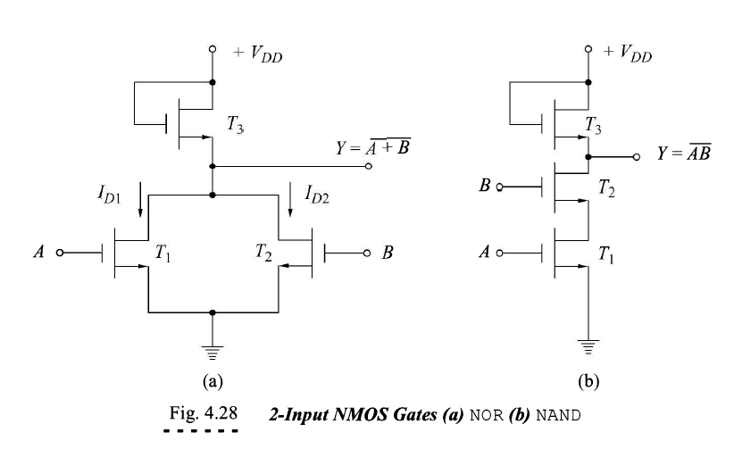
Mos nand & nor gates
D
D
G
G
G
G
S
S
S
Notes:
All transistors T1, T2 and T3 are Enhancement type N-MOSFET. When there is no voltage on the gate terminal then enhancement MOS does not conduct, i.e in OFF state. More voltage applied on the gate terminal, the device has good conductivity. So when HIGH voltage applied on gate terminal, the device is then in ON state. Usually threshold voltage of NMOS is Vt = 1 V. So if 1 V or more applied at gate terminal, the device starts conducting.

Slide 10
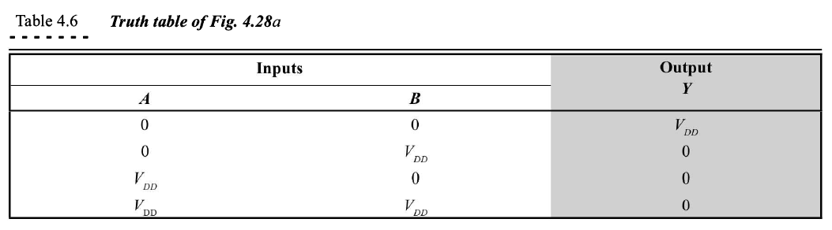
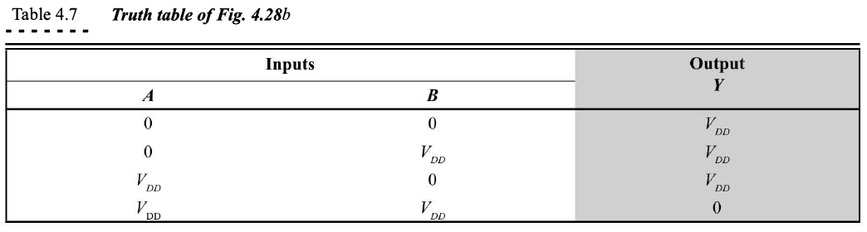
Mos nand & nor gates
Truth Table of NMOS NOR and NAND gates
All transistors T1, T2 and T3 are Enhancement type NMOS.
When there is no voltage(zero volt) on the gate terminal then enhancement MOS does not conduct, i.e in OFF state.
More positive voltage applied on the gate terminal, the device has good conductivity. So when HIGH voltage applied on gate terminal, the device is then in ON state.
Usually threshold voltage of Enhancement type NMOS is Vt = 1 V. So if +1V or more applied at gate terminal, the device starts conducting.
Notes:
Write the states (ON/OFF) of each transistor T1, T2 and T3 for each combination of inputs during exam

Slide 11
Cmos logic
A complementary MOSFET (CMOS) is obtained by connecting a p-channel and an n-channel MOSFET in series, with drains tied together and the output is taken at the common Gate.
In CMOS technology, both N-type and P-type transistors are used to design logic functions.
Input is applied at the common gate formed by connecting the two gates together (See the figure in next slide).
In a CMOS, p-channel and n-channel enhancement MOS devices are fabricated on the same chip, which makes its fabrication more complicated and reduces the packing density.
CMOS has become the most popular in MSI and LSI areas and is the only possible logic for the fabrication of VLSI devices.

Slide 12
Basic cmos logic/CMOS inverter
The basic CMOS logic circuit is an inverter where the logic levels are 0 V (logic 0) and VDD(logic 1).
The same signal which turns ON a transistor of one type is used to turn OFF a transistor of the other type.
When Vi = VDD, T1 turns ON and T2 turns OFF. Therefore Vo is equivalent to 0 V, and since the transistors are connected in series the current ID is very small.
On the other hand, when Vi = 0 V, T1 turns OFF and T2 turns ON giving an output voltage Vo is equivalent to Vdd and ID is again very small.
In either logic state, T1 or T2 is OFF and the dormant power dissipation which is the product of the OFF leakage current and Vdd is very low.

Slide 13
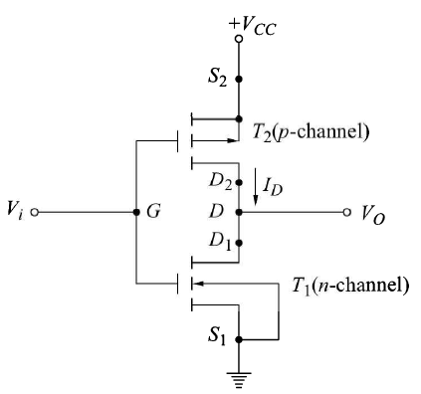
Cmos inverter
When Vi = 0V
Vgs2 = Vg – Vs = 0 – 5 = -5V So T2 is ON
Vgs1 = Vg – Vs = 0 – 0 = 0V. So T1 is OFF
When Vi = 5V
Vgs2 = Vg – Vs = 5 – 5 = 0V. So T2 is OFF
Vgs1 = Vg – Vs = 5 – 0 = 5V. So T1 is ON
Notes:
Transistor T1 is Enhancement type N-MOS
Transistor T2 is Enhancement type P-MOS

Slide 14
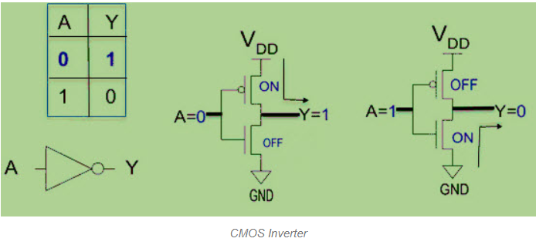
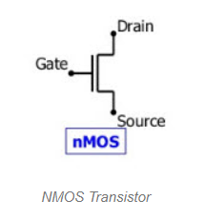
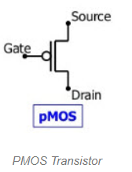
CMOS Inverter
The input A serves as the gate voltage for both transistors.
The NMOS transistor has an input from Vss (ground) and PMOS transistor has an input from Vdd. The terminal Y is output.
When a high voltage (~ Vdd) is given at input terminal (A) of the inverter, the PMOS becomes open circuit and NMOS switched ON so the output will be pulled down to Vss.
When a low-level voltage (<Vdd, ~0v) applied to the inverter, the NMOS switched OFF and PMOS switched ON. So the output becomes Vdd or the circuit is pulled up to Vdd.

Slide 15
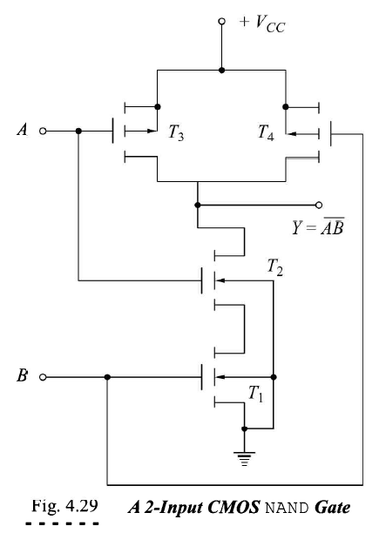
Cmos nand
S
S
G
G
D
D
D
G
S
D
G
S
Notes:
Transistors T1 and T2 are Enhancement type N-MOS
Transistors T3 and T4 are Enhancement type P-MOS

Slide 16
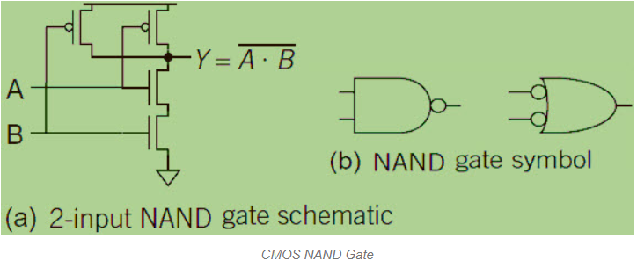
Cmos nand
The below figure shows a 2-input Complementary MOS NAND gate. It consists of two series NMOS transistors between Y and Ground and two parallel PMOS transistors between Y and VDD.
If either input A or B is logic 0, at least one of the NMOS transistors will be OFF, breaking the path from Y to Ground. But at least one of the PMOS transistors will be ON, creating a path from Y to VDD.
Hence, the output Y will be high. If both inputs are high, both of the NMOS transistors will be ON and both of the PMOS transistors will be OFF. Hence, the output will be logic low.

Slide 17
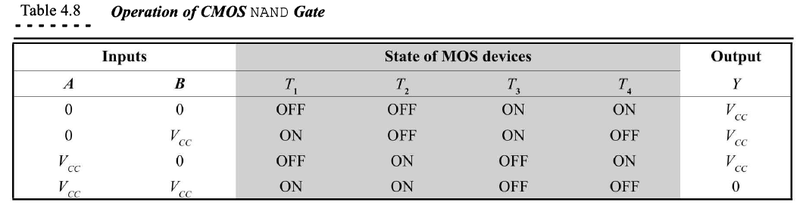
CMOS NAND

Slide 18
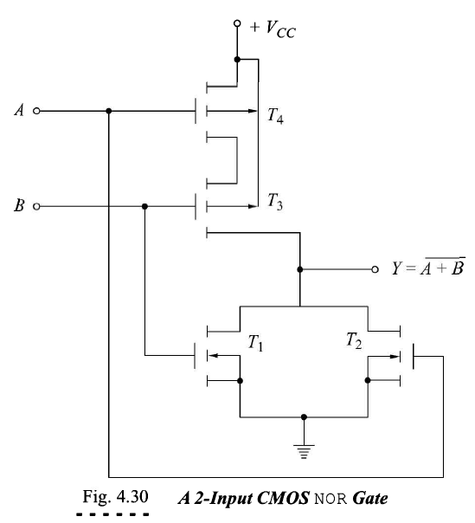
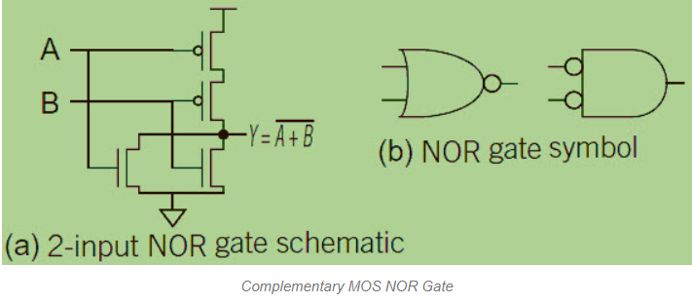
Cmos nor
S
G
D
G
S
D
D
D
G
G
S
S
Notes:
Transistors T1 and T2 are Enhancement type N-MOS
Transistors T3 and T4 are Enhancement type P-MOS

Slide 19
CMOS applications & uses
CMOS technology is one of the most popular technology in the computer chip design industry and broadly used today to form ICs in numerous and varied applications.
Today’s computer memories, CPUs and cell phones make use of this technology due to several key advantages.
This is a technology that makes use of both P channel and N channel semiconductor devices.
This is the dominant semiconductor technology for microprocessors, microcontroller chips, memories like RAM, ROM, EEPROM and application specific integrated circuits (ASICs).
The main advantage of CMOS over NMOS and BIPOLAR technology is the much smaller power dissipation.

Slide 20
reference
CHAP 4 of R.P JAIN’s book

